Slide 1


Automobile Engineering: Vehicle dynamics for Beginners
Akhila Vulluri
Company confidential

Slide 2
Content:
Introduction
Automotive System
Concepts Of Automotive Engineering
Concepts Of Physics
Vehicle Load Cases
Tire Mechanics
Introduction To Suspension
Longitudinal Dynamics
Lateral Dynamics
Handling And Steering Performance
Vertical Dynamics
Roll Over

Slide 3
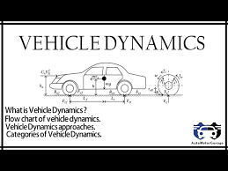
1.Introduction
Vehicle dynamics is the study of the forces and motions that affect a vehicle's performance, handling, and stability during movement. It is an essential field of automotive engineering that integrates mechanical, electrical, and control systems to ensure a vehicle behaves predictably and safely across different driving conditions.
Vehicle dynamics aims to optimize vehicle design for factors such as comfort, safety, fuel efficiency, and performance. Understanding how a vehicle interacts with the road and responds to driver inputs is critical in ensuring that the vehicle performs efficiently, whether on highways, in urban environments, or off-road.

Slide 4
2.Automotive System
1. Types Of Drives
2. Weight Distribution
Company confidential

Slide 5
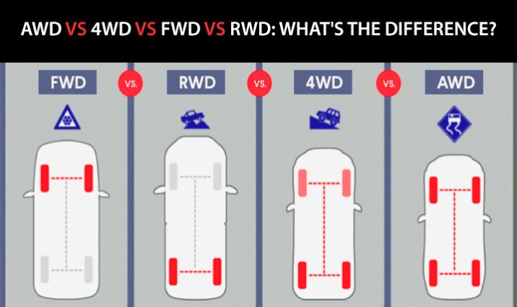
Types of Drives
Front-Wheel Drive (FWD) FWD sends power to the front wheels, providing better traction in slippery conditions and fuel efficiency. It is lighter and cost-effective but may suffer from torque steer in high-performance vehicles.
Rear-Wheel Drive (RWD) RWD delivers power to the rear wheels, offering improved handling and acceleration. It’s favored in performance and luxury vehicles but provides less traction on slippery surfaces.
All-Wheel Drive (AWD) AWD powers all wheels either continuously or as needed, improving stability and grip across various terrains. It is ideal for diverse weather conditions but adds weight and complexity.
Four-Wheel Drive (4WD) 4WD is designed for off-road use, offering high traction in rugged conditions through manually engaging all four wheels. It includes low-range gearing for challenging terrains.
Notes:
Examples: fwd Compact Cars, Economy Cars:
Rwd Sports Cars, Luxury Cars, | AWD Sports Sedans SUV’s | 4WD Off-Road SUV (JEEP) trucks

Slide 6
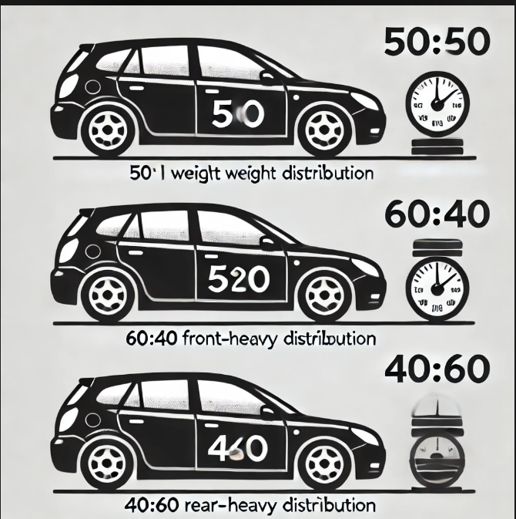
Weight Distribution
Weight distribution refers to how the total weight of a vehicle is spread across its axles, significantly affecting its handling, stability, and performance. It is often expressed as a percentage of the total weight on the front and rear axles.
For example:
A 50:50 weight distribution (equal front and rear) provides balanced handling and predictable cornering behavior.
A front-heavy distribution (e.g., 60:40) improves traction on the front wheels, which is beneficial for front-wheel-drive vehicles.
A rear-heavy distribution (e.g., 40:60) is common in sports cars and rear-wheel-drive vehicles, enhancing rear tire grip during acceleration.

Slide 7
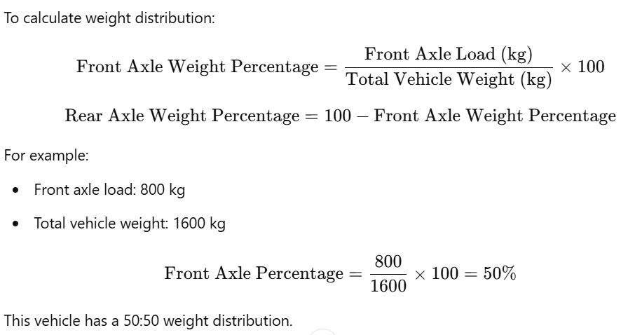
Calculation Example:

Slide 8

3.Concepts Of Automotive Engineering
Center Gravity
Gear Ratio
Company confidential

Slide 9
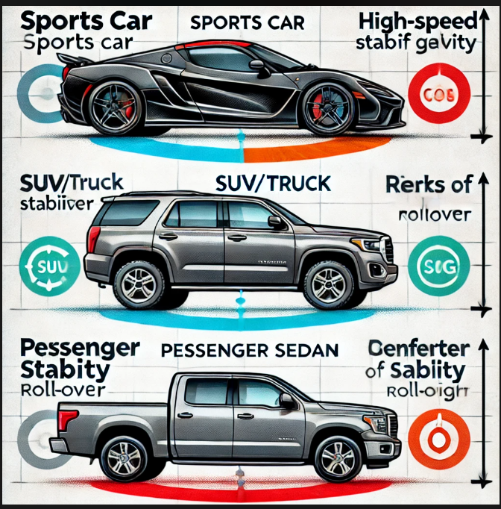
Center of Gravity
Center of Gravity (CoG)
The Center of Gravity (CoG) refers to the point where a vehicle's mass is evenly distributed in all directions. It plays a crucial role in a vehicle's stability, handling, and safety. A vehicle's CoG is determined by the distribution of its mass, including the engine, chassis, passengers, and cargo.
Optimizing CoG for Different Vehicle Types:
Sports Cars: Low CoG is critical to ensure high-speed stability and agility. A low CoG improves cornering ability and reduces body roll.
SUVs/Trucks: These vehicles typically have a higher CoG, which can lead to reduced handling performance and an increased risk of rollover. Engineers work to mitigate these risks by designing stability control systems and optimizing the suspension and wheelbase.
Passenger Sedans: Typically, sedans have a moderate CoG that balances comfort, handling, and stability for general driving purposes.

Slide 10
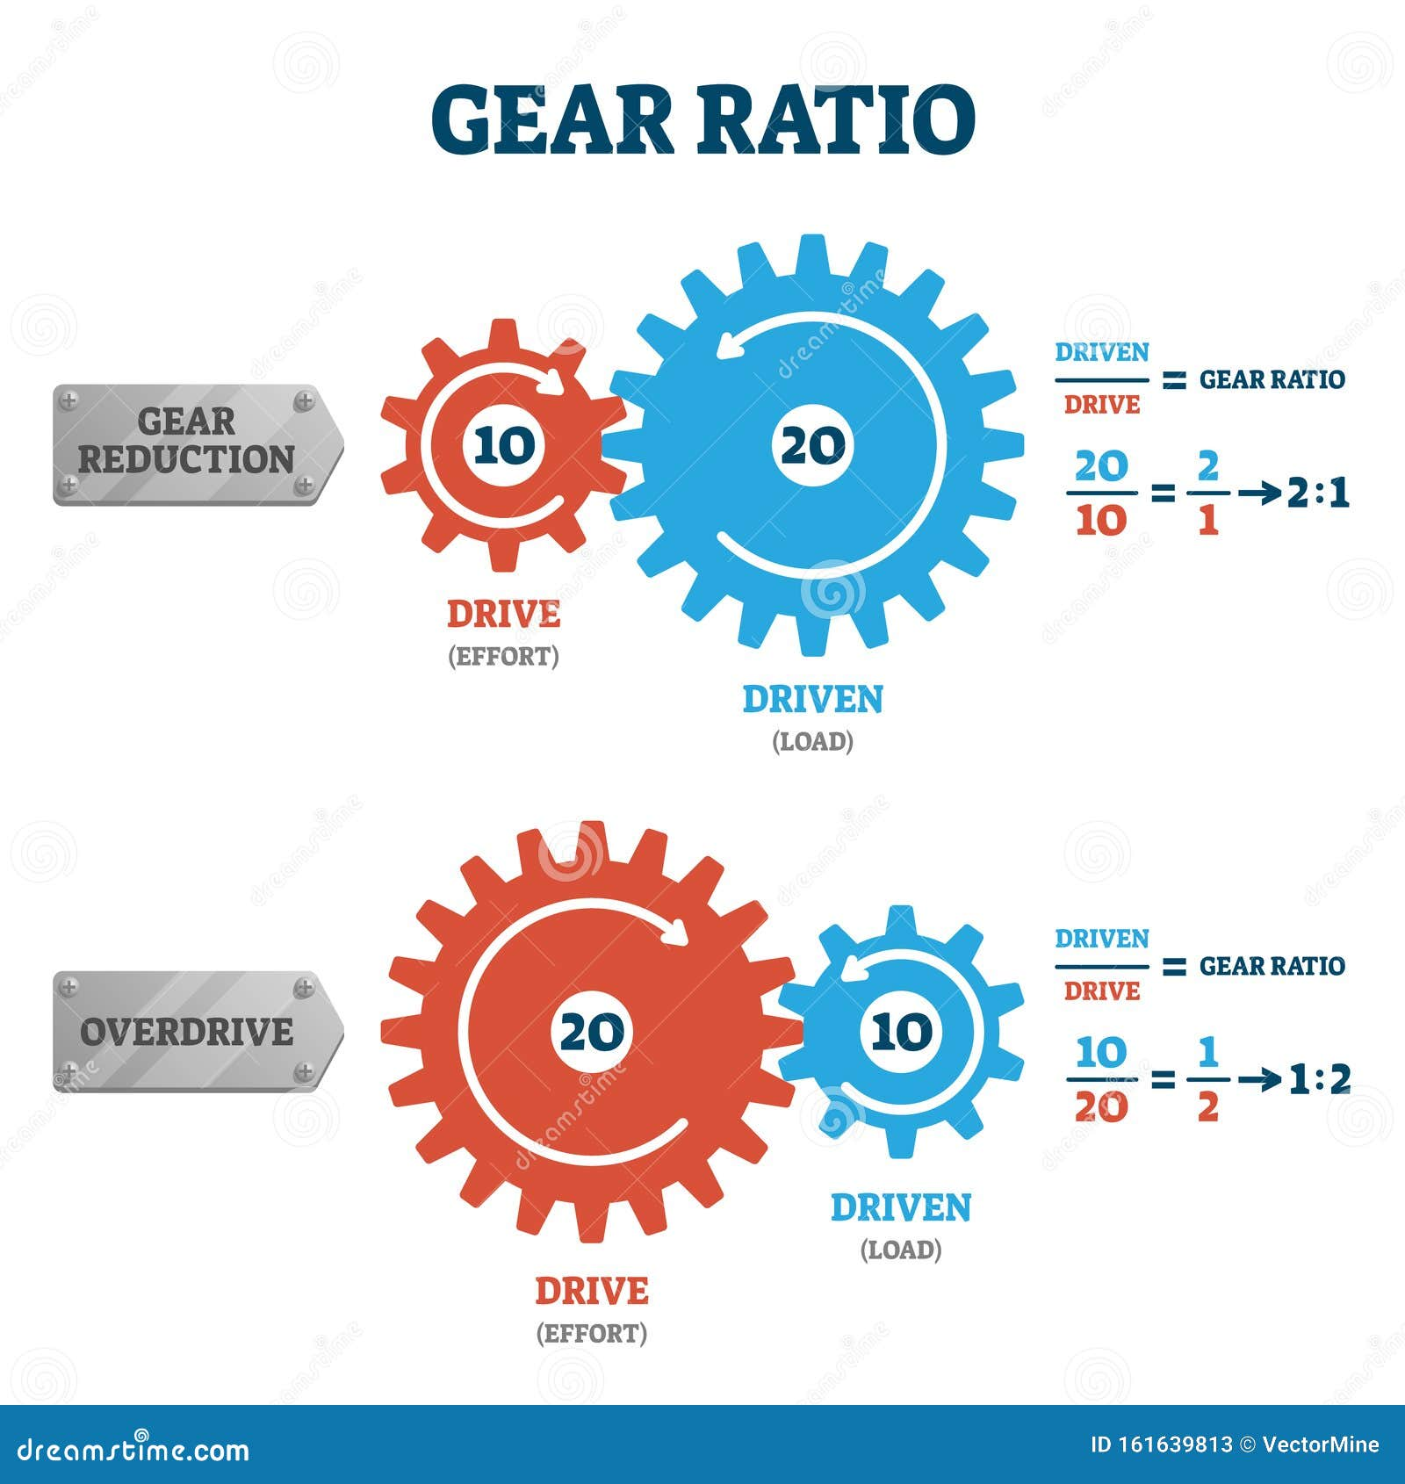
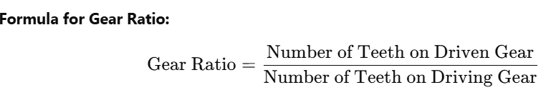
Gear Ratio
Gear Ratio
The gear ratio refers to the ratio between the number of teeth on two meshing gears, which determines how torque and rotational speed are transferred from one gear to another in a transmission system. It plays a critical role in controlling the acceleration, top speed, and fuel efficiency of a vehicle
Driving Gear: The gear that is powered by the engine or motor.
Types of Gear Ratios:
High Gear Ratio A high gear ratio means the driven gear has more teeth than the driving gear. It provides more torque and slower speed, which is useful for acceleration and climbing. However, it leads to lower top speeds. Example: 4:1 gear ratio (for every 1 rotation of the driving gear, the driven gear rotates 1/4th of the time).
Low Gear Ratio A low gear ratio means the driven gear has fewer teeth than the driving gear, resulting in higher speed and less torque. This is ideal for cruising at higher speeds with better fuel efficiency. Example: 1:3 gear ratio (for every 1 rotation of the driving gear, the driven gear r

Slide 11
4. Concepts Of Physics
1. Newtons Laws Of Motion
2. Rolling Resistance
Company confidential

Slide 12

Newton's Laws of Motion
1. First Law (Law of Inertia):
The first law states: An object will remain at rest, or in uniform motion in a straight line, unless acted upon by an external force.
Example in Vehicle Dynamics:
Braking: When you apply brakes to a moving car, the car will decelerate and eventually stop due to the external force of friction between the tires and the road surface.
Turning: A vehicle will continue to travel straight ahead unless the steering input provides an external force to change its direction.
2. Second Law (Law of Acceleration):
The second law states: The acceleration of an object is directly proportional to the net force acting upon it and inversely proportional to its mass.

Slide 13
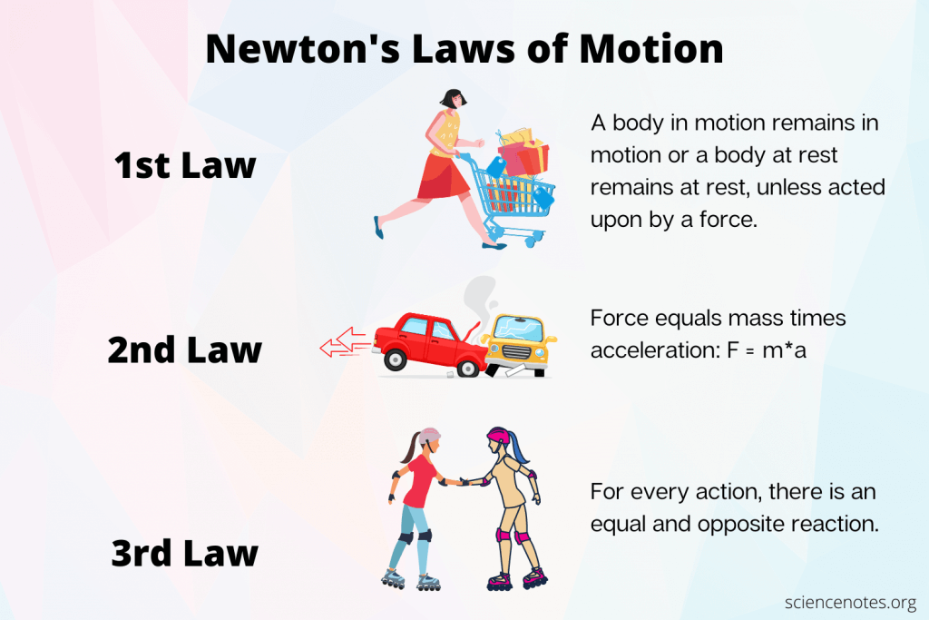
Example in Vehicle Dynamics:
Acceleration: When you press the accelerator pedal, the engine generates force to increase the car’s speed. A car with a smaller mass will accelerate faster than a heavier one with the same force applied.
Braking: The braking force must overcome the vehicle's inertia to decelerate. A larger, heavier vehicle requires more braking force to stop.
3. Third Law (Action and Reaction):
The third law states: For every action, there is an equal and opposite reaction.
Example in Vehicle Dynamics:
Acceleration: When a car accelerates, the tires push against the road, and the road exerts an equal and opposite force that propels the car forward.
Braking: When you apply the brakes, the tires apply a braking force to the road, and the road pushes back with an equal force, bringing the vehicle to a stop.
Turning: When a vehicle turns, the tires exert a force on the road surface, and the road surface exerts an equal and opposite force that changes the vehicle's direction.

Slide 14
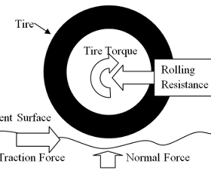
Rolling Resistance
Rolling resistance (also known as rolling friction) is the force that resists the motion of a rolling object, such as a vehicle's tire, on a surface. Unlike sliding friction, which occurs when two surfaces slide past each other, rolling resistance is caused by the deformation of the tire as it rolls over the ground. This deformation leads to energy loss in the form of heat and reduces the efficiency of vehicle movement, impacting fuel consumption and overall performance.
Factors Affecting Rolling Resistance:
Tire Material and Construction: The composition of the tire material plays a significant role in rolling resistance. Tires made of soft, flexible materials tend to deform more, resulting in higher rolling resistance. Harder or stiffer tire compounds, such as those found in performance or low-resistance tires, deform less, reducing energy loss.
Tire Pressure: Low tire pressure increases the contact area between the tire and the road, which causes more deformation and thus higher rolling resistance. Proper tire inflation is crucial for minimizing rolling resistance and maximizing fuel efficiency. Under-inflated tires lead to higher energy losses due to excessive tire deformation.

Slide 15
Rolling Resistance
Tire Width: Wider tires typically have a larger contact patch with the road, which can lead to higher rolling resistance because more of the tire surface is deformed. However, wider tires can also improve grip, especially for high-performance or off-road vehicles, so there is often a trade-off between rolling resistance and handling performance.
Road Surface: The texture and material of the road surface affect rolling resistance. Rougher, uneven surfaces cause more tire deformation than smooth roads, increasing rolling resistance. For instance, driving on gravel or dirt roads results in higher resistance compared to smooth asphalt highways.
Tire Temperature: As tires heat up from continuous rolling, the material becomes softer, which can increase rolling resistance. Higher temperatures often lead to more tire deformation, especially under heavy loads or at high speeds.

Slide 16

5. Vehicle Load Cases
1. Statis Load
2. Accelerating And Braking
3. External Loads
4. Aerodynamic Loads
5. Cornering Loads
Company confidential

Slide 17
Vehicle Load Cases
In vehicle dynamics, load cases refer to various forces and conditions a vehicle experiences during different driving scenarios. Understanding these loads is critical for optimizing vehicle design, safety, and performance. The main load cases include static loads, dynamic loads from acceleration and braking, external loads, aerodynamic forces, and cornering loads.
1. Static Load
Static load refers to the forces acting on the vehicle when it is stationary or moving at a constant speed without any acceleration or deceleration. These loads primarily come from the vehicle's weight, which is due to gravity, and are distributed across the tires, suspension, and chassis.
Weight Distribution: The weight of the vehicle is supported by the tires, and the distribution of this weight between the front and rear axles is critical for maintaining balance and stability. Uneven weight distribution can cause uneven tire wear and affect handling.
Effect on Suspension: Static load influences how the suspension system is designed to absorb weight and prevent the vehicle from bottoming out under its own weight. The spring rates, damping forces, and shock absorber settings are selected based on the static load characteristics.
Example in Vehicle Dynamics:
A car that is parked on flat ground experiences a static load distributed evenly (or unevenly, depending on the design). The suspension must be designed to support the vehicle's weight without excessive deflection or sag.

Slide 18
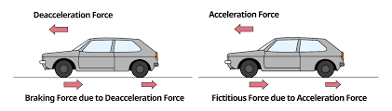
2. Accelerating and Braking Loads
When a vehicle accelerates or brakes, dynamic forces come into play. These forces affect the weight distribution and the interaction between the tires and the road.
Accelerating Loads: During acceleration, the vehicle's inertia causes a shift in weight towards the rear. The rear tires experience an increase in load, which enhances traction, while the front tires experience a reduction in load, which can reduce braking ability.
Braking Loads: During braking, the weight shifts forward, increasing the load on the front tires. This is why most vehicles have larger braking systems at the front, as the front brakes need to handle more of the braking force. If braking forces exceed the available friction between the tires and the road, the vehicle can skid.
Example in Vehicle Dynamics:
When a car accelerates quickly, the rear of the vehicle experiences a higher load on the rear tires, increasing the traction and allowing the car to move forward.
During hard braking, the front tires bear more weight, so the braking system is designed to handle more force to stop the vehicle efficiently.

Slide 19
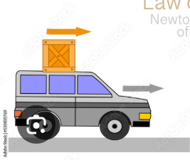
3. External Loads
External loads refer to forces applied to the vehicle from external sources, such as passengers, cargo, and environmental conditions like wind or road irregularities.
Passenger and Cargo Load: The weight of passengers and cargo affects the overall weight of the vehicle and its distribution. Heavier cargo or more passengers will increase the load on the vehicle, potentially affecting handling, fuel efficiency, and suspension performance.
Wind Loads: Crosswinds and gusts of wind can impose additional forces on a vehicle, especially at higher speeds. Wind loads can cause yawing (side-to-side motion) or affect the vehicle's stability, especially for larger or taller vehicles.
Example in Vehicle Dynamics:
A loaded truck with cargo in the rear will have different handling characteristics than an unloaded truck. The cargo adds weight, changes the weight distribution, and can affect the handling and braking performance.

Slide 20
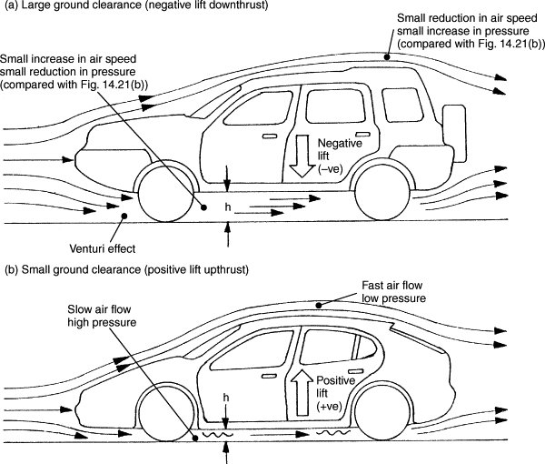
4. Aerodynamic Loads
Aerodynamic loads are the forces acting on a vehicle due to air resistance (drag) and downforce, which are particularly relevant at high speeds.
Drag Force: This is the resistance encountered by the vehicle as it moves through the air. The faster the vehicle moves, the higher the drag force, which requires more engine power to overcome. Aerodynamic design plays a major role in reducing drag and improving fuel efficiency.
Downforce: This is the vertical force that pushes the vehicle towards the road, increasing tire grip and stability. Race cars, for example, are designed with spoilers and diffusers to generate downforce, improving cornering performance and preventing the car from lifting off the ground at high speeds.
Example in Vehicle Dynamics:
A sports car at high speed will generate downforce, which pushes the car towards the ground and increases tire grip, allowing for faster cornering. However, this increases drag, requiring more power to maintain speed.

Slide 21
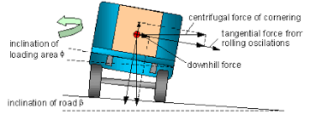
5. Cornering Loads
Cornering loads occur when a vehicle turns. These loads are generated by the forces acting on the vehicle due to its inertia and the tires' friction with the road during a turn.
Centripetal Force: During a turn, the vehicle must exert an inward force (centripetal force) to change direction. The tires experience lateral forces that push them sideways, which can cause the vehicle to experience body roll or understeer/oversteer depending on the load distribution and tire traction.
Weight Transfer in Cornering: As the vehicle turns, weight is transferred to the outside tires, increasing the load on those tires and reducing the load on the inside tires. The suspension must be designed to handle these forces, maintaining balance and stability during the turn.
Example in Vehicle Dynamics:
In a sharp turn, the vehicle’s outer tires will experience more load, which can lead to understeer (loss of grip at the front tires) or oversteer (loss of grip at the rear tires). Proper weight distribution and suspension setup are crucial for balanced cornering performance.

Slide 22

6. Tire Mechanics
1.Tires Construction And Importance
2. Viscos Elastic Behavior Of Rubber
3.Factor Of Rolling Resistance
4.Tire Effects
Company confidential

Slide 23
Tire Mechanics
Tire mechanics is an essential part of vehicle dynamics, as tires play a crucial role in the performance, safety, and efficiency of a vehicle. Understanding tire construction, material behavior, rolling resistance, and their effects on vehicle performance helps in optimizing both handling and fuel efficiency. Below are some critical aspects of tire mechanics:
1. Tire Construction and Importance
Tires are one of the most critical components of a vehicle, connecting the vehicle to the road. Their construction is complex and engineered to balance several factors, including durability, safety, performance, and fuel efficiency. A typical tire consists of multiple layers, each designed to handle specific stresses and conditions.
Tire Layers:
Tread: The outermost layer of the tire that comes into direct contact with the road. It is made from a rubber compound designed for traction, wear resistance, and comfort. The tread pattern helps channel water away from the tire to reduce hydroplaning.
Belt Plies: These are layers of steel or fabric placed beneath the tread. They provide strength, rigidity, and improve tire longevity, contributing to the tire's handling capabilities.
Sidewall: The sidewall is the part of the tire that connects the tread to the bead. It provides flexibility and strength, protecting the inner layers from impacts and helping the tire withstand various loads.
Bead: The bead is the part of the tire that forms a tight seal around the rim. It ensures that the tire stays in place on the wheel during operation.
Inner Liner: This is a rubber layer that holds air inside the tire and helps maintain tire pressure by preventing air leakage.

Slide 24
2. Viscoelastic Behavior of Rubber
Rubber, the primary material used in tire construction, exhibits viscoelastic behavior, meaning it has both viscous (resistance to flow) and elastic (ability to return to its original shape) properties. The combination of these two behaviors significantly affects tire performance, particularly in terms of grip, ride comfort, and rolling resistance.
Elastic Component: The elastic behavior refers to the tire’s ability to deform under load and return to its original shape. This is crucial for maintaining the tire's contact with the road, which influences traction and handling.
Viscous Component: The viscous behavior relates to how the rubber resists deformation under load over time. As tires roll, the friction between the tire and road causes internal friction within the rubber, converting kinetic energy into heat. This process is responsible for rolling resistance, which reduces fuel efficiency.
Effect on Tire Performance:
Traction and Grip: The elastic properties of rubber allow the tire to conform to the surface, enhancing grip, especially in dry conditions.
Wear and Durability: The viscous component contributes to wear, especially under high temperatures, as the internal friction leads to heat buildup and tread wear.
Comfort and Noise: The combination of elasticity and viscosity also influences ride comfort. Softer rubber compounds (more elastic) can provide a smoother ride but may wear out faster, while harder compounds (less elastic) are more durable but can result in a harsher ride.
Example in Vehicle Dynamics:
A high-performance tire with a softer, more elastic rubber compound provides excellent grip on dry roads but may wear out faster compared to an all-season tire with a harder compound.

Slide 25
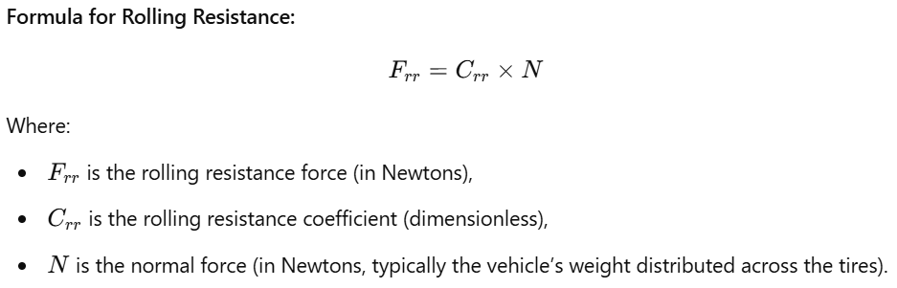
3. Factors of Rolling Resistance
Rolling resistance is the force that opposes the motion of a tire rolling on a surface. It is a key factor affecting vehicle fuel efficiency and performance. Rolling resistance occurs due to the deformation of the tire as it rolls under the vehicle's weight. The tire’s contact patch with the road surface causes the tire to flatten, which requires energy.
Several factors influence rolling resistance:
Tire Construction: Tires with stiffer sidewalls or more rigid belts tend to deform less and thus have lower rolling resistance. Softer tires with more flex, like those designed for comfort or off-road use, tend to have higher rolling resistance.
Tire Pressure: Lower tire pressure increases the contact area between the tire and the road, causing more deformation and higher rolling resistance. Properly inflated tires help minimize rolling resistance.
Tire Material: The type of rubber and its compounds used in the tire significantly affect rolling resistance. Tires with high-silica compounds have lower rolling resistance compared to tires made from traditional carbon black compounds.
Road Surface: The smoother the road surface, the lower the rolling resistance. Rough, uneven surfaces cause the tire to deform more, increasing energy loss.
Example in Vehicle Dynamics:
Tires with low rolling resistance, such as those found on hybrid or electric vehicles, reduce energy losses and improve fuel efficiency, particularly on highways.

Slide 26
4. Tire Effects on Vehicle Dynamics
Tires have a profound impact on the overall handling, stability, comfort, and performance of a vehicle. The effects of tires on vehicle dynamics are seen in several key areas:
Grip and Traction: The tire’s ability to grip the road is one of the most important factors influencing vehicle handling. The contact patch (the portion of the tire that touches the road) and the tire’s tread design and compound determine how well a tire can transmit forces between the road and the vehicle.
Tread Pattern: Tires with aggressive tread patterns are ideal for off-road or wet conditions but may sacrifice performance on dry, smooth roads.
Handling and Cornering: The tire’s construction, including the sidewall stiffness and the rubber compound, affects how the vehicle responds to steering inputs and maintains stability during cornering.
Understeer and Oversteer: The balance between the front and rear tires’ grip determines whether a vehicle experiences understeer (when the vehicle turns less sharply than intended) or oversteer (when the vehicle turns more sharply than intended).
Ride Comfort: Tire performance is also closely linked to ride comfort. Softer tires provide better shock absorption, making the ride smoother, while harder tires tend to be more rigid, leading to a rougher ride.
Sidewall Flexibility: Tires with more flexible sidewalls can provide a smoother ride but may sacrifice precision and stability in handling.
Noise and Vibration: The material properties of the tire, including the type of rubber compound and tread pattern, influence the amount of road noise and vibration the vehicle generates.
Low Noise Tires: Certain tire designs are engineered to minimize road noise for a quieter ride.
Example in Vehicle Dynamics:
A performance sports car typically uses low-profile tires with a stiff sidewall and a high-performance tread compound to improve cornering ability and handling precision. However, this may come at the cost of a less comfortable ride.

Slide 27
7.Introduction to suspension
1.Constituts of a suspensions 2. What happens if there is no suspension
Company confidential

Slide 28
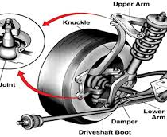
Introduction to suspension
A vehicle's suspension system is critical for ensuring comfort, stability, and control. It absorbs shocks from uneven road surfaces, maintains tire contact with the ground, and stabilizes the vehicle during various driving conditions. Suspension systems are designed to balance performance, comfort, and safety
1. Constituents of a Suspension System
A suspension system consists of various components, each designed to perform a specific function. Together, these components ensure the vehicle's ability to handle rough terrain, provide comfort, and maintain control.
Springs: Springs absorb energy from road impacts and help maintain the vehicle's ride height. Common types include:
Coil Springs: Used in most modern vehicles for their compactness and reliability.
Leaf Springs: Often used in trucks and heavy vehicles for durability.
Torsion Bars: Found in some vehicles, using a twisting bar to absorb shocks.

Slide 29
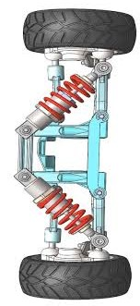
Shock Absorbers (Dampers): These control the energy absorbed by the springs, preventing excessive bouncing. They convert kinetic energy from spring motion into heat and dissipate it.
Control Arms: Control arms connect the wheels to the vehicle's frame and allow them to move up and down independently. They also help maintain wheel alignment.
Stabilizer Bars (Anti-roll Bars): These reduce body roll during cornering by distributing the load between the wheels on opposite sides of the vehicle.
Bushings and Mounts: These components reduce vibrations and noise by cushioning the connections between suspension parts.
Struts: A combination of a spring and a shock absorber, struts provide structural support and damping in a single unit.
Example in Vehicle Dynamics:
A sedan typically uses a combination of coil springs, shock absorbers, and stabilizer bars to ensure a comfortable yet responsive ride.

Slide 30
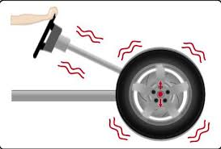
2. What Happens If There Is No Suspension?
Without a suspension system, vehicles would be unable to provide a safe or comfortable driving experience. The absence of suspension affects every aspect of vehicle dynamics, including comfort, control, and safety.
Uncomfortable Ride: Without suspension, passengers would feel every bump, pothole, and irregularity on the road. The vibrations and shocks would be directly transmitted to the vehicle's body.
Reduced Stability: Suspension systems help maintain tire contact with the ground. Without suspension, the tires could lose contact with the road during uneven surfaces, reducing stability and increasing the risk of accidents.
Poor Handling: Suspension systems distribute forces during cornering, braking, and acceleration. Without them, the vehicle would be difficult to control, especially during sharp turns or sudden maneuvers.
Increased Wear and Tear: Suspension protects the vehicle's chassis and components from the stresses of road impacts. Without it, these parts would experience higher levels of stress, leading to premature wear and damage.
Safety Risks: A vehicle without suspension would be highly unsafe. Loss of traction, increased body roll, and reduced control would make driving dangerous.
Example in Vehicle Dynamics:
Driving over a speed bump without suspension would cause a severe jolt to the vehicle’s body and occupants, potentially leading to damage or loss of control.

Slide 31
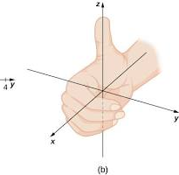
Longitudinal Dynamics: Focused on forces along the forward and backward direction (e.g., acceleration and braking). Represented by arrows pointing forward and backward along the car's length.
Lateral Dynamics: Focused on forces side-to-side (e.g., turning and cornering). Represented by arrows pointing left and right from the car's sides.
Vertical Dynamics: Focused on up-and-down motions (e.g., suspension and vibration). Represented by arrows pointing up and down above and below the car.

Slide 32
8.Longitudinal Dynamics
Label option
1.Tractive Force 2.Brakng Performance 3. Force Analysis 4. Torque Transfer And Inertia 5.Anti Lock Brakes
Company confidential

Slide 33
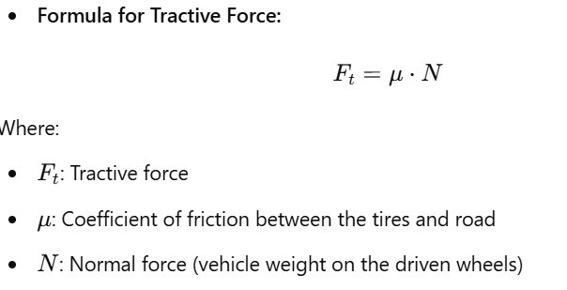
Longitudinal Dynamics
Longitudinal dynamics deal with the forces and motions of a vehicle along its length, including acceleration, deceleration, and braking. These dynamics govern how efficiently a vehicle can move forward or backward and how well it responds to inputs like acceleration or braking. Below are key aspects of longitudinal dynamics:
1. Tractive Force
Tractive force is the force exerted by the tires on the road to propel the vehicle forward. It is generated by the engine torque transmitted through the drivetrain to the wheels. Tractive force determines the vehicle’s ability to accelerate, climb inclines, and maintain traction.
Limiting Factor: The maximum tractive force is limited by the available friction between the tires
and the road. If the engine produces more torque than the tires can handle, the wheels
may spin, causing a loss of traction.
Example in Vehicle Dynamics:
A sports car with high-performance tires generates more tractive force on dry asphalt
than an off-road vehicle on loose gravel, allowing quicker acceleration.

Slide 34
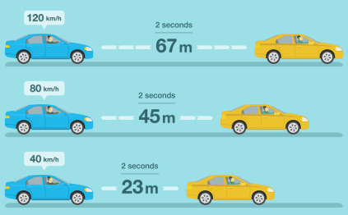
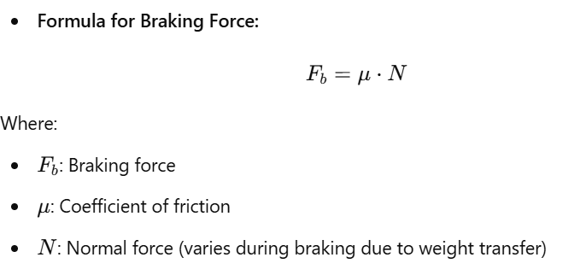
2. Braking Performance
Braking performance is a measure of how effectively a vehicle can decelerate or come to a stop. The braking force is applied through the braking system, transferring energy from the moving vehicle into heat via the brakes.
Key Factors Affecting Braking Performance:
Tire-road interaction: The friction between the tires and the road is critical for effective braking.
Weight distribution: Braking shifts weight forward, increasing the load on the front tires, which improves their braking capability but reduces it on the rear tires.
Brake design: Disc brakes generally provide better performance than drum brakes due to their ability to dissipate heat.
Example in Vehicle Dynamics:
A vehicle equipped with anti-lock braking systems (ABS) optimizes braking force by preventing wheel lock-up, maintaining traction even under hard braking.

Slide 35
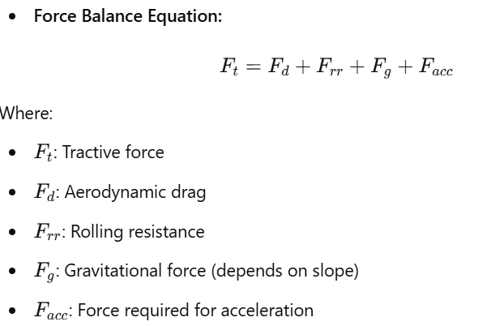
3. Force Analysis
Force analysis in longitudinal dynamics involves evaluating all forces acting on a vehicle during motion, including tractive force, aerodynamic drag, rolling resistance, and gravitational forces (especially on inclines).
Key Forces:
Tractive Force: Propels the vehicle forward.
Aerodynamic Drag: Opposes motion and increases with the square of velocity.
Rolling Resistance: Energy loss due to tire deformation.
Gravitational Force: Acts against motion when climbing inclines and aids motion when descending
Example in Vehicle Dynamics:
While climbing a steep hill, the tractive force must overcome both
rolling resistance and gravitational force to maintain a steady speed.

Slide 36
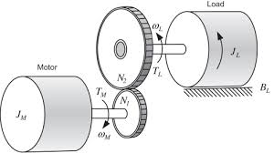
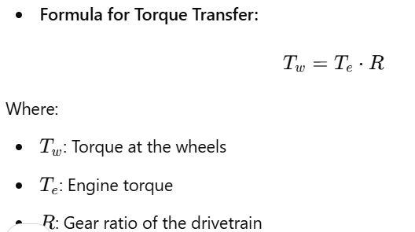
4. Torque Transfer And Inertia
Torque transfer and inertia are essential aspects of a vehicle’s acceleration and deceleration dynamics. Torque is generated by the engine and transferred through the drivetrain to the wheels, while inertia is the resistance of a vehicle to changes in motion.
Torque Transfer:
Engine torque is multiplied by the gear ratio and transmitted to the wheels.
Torque distribution varies between front-wheel drive, rear-wheel drive, and all-wheel drive vehicles.
Inertia:
Inertia resists changes in motion. A heavier vehicle requires more torque to accelerate and more braking force to decelerate.
Example in Vehicle Dynamics:
In a sports car, low gears provide high torque at the wheels for
quick acceleration, while higher gears are used for efficiency at higher speeds.

Slide 37
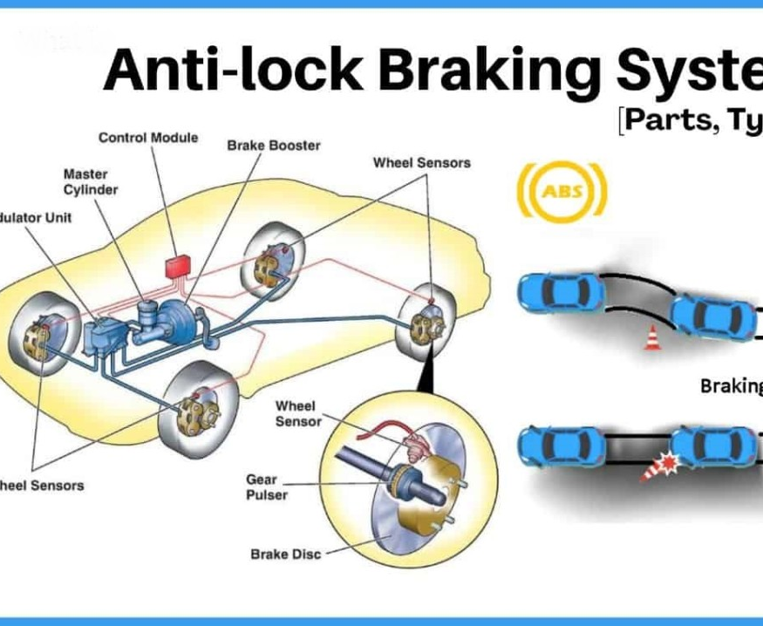
5. Anti-lock Braking Systems (ABS)
Anti-lock Braking Systems (ABS) are safety systems that prevent the wheels from locking up during hard braking. By modulating the braking pressure applied to each wheel, ABS ensures that the tires maintain traction and the vehicle remains steerable.
How ABS Works:
Sensors monitor the rotational speed of each wheel.
When a wheel is about to lock, the ABS controller reduces brake pressure on that wheel momentarily, allowing it to rotate.
This cycle repeats rapidly to optimize braking force without wheel lock-up.
Benefits of ABS:
Maintains steering control during emergency braking.
Reduces stopping distance on certain surfaces.
Prevents skidding and loss of control.
Example in Vehicle Dynamics:
During emergency braking on wet roads, ABS prevents wheel lock-up, allowing the driver to steer around obstacles while maintaining maximum braking efficiency.

Slide 38
9. Lateral Dynamics
Label option
1.Lateral Dynamics And Low Speed Turning
2.High-speed Turning
3.Understeer Oversteer
4.Roll- Weight Transfer Equation
Company confidential

Slide 39
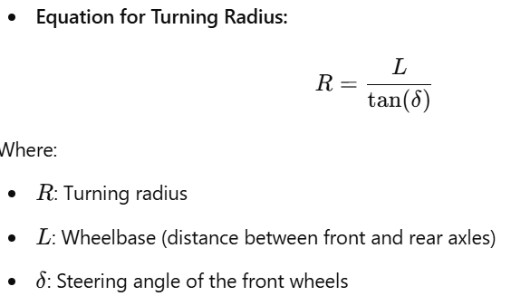
Lateral Dynamics
Lateral dynamics focus on the forces and motions acting on a vehicle when it moves laterally (side to side), such as during turning or lane changes. Understanding these dynamics is crucial for analyzing handling, stability, and safety, especially during cornering or evasive maneuvers. Below are the key aspects of lateral dynamics:
1. Lateral Dynamics and Low-Speed Turning
At low speeds, lateral dynamics are influenced primarily by the steering geometry and the tire-road interaction. In low-speed turning, the tires generate lateral forces to guide the vehicle through a curved path.
Key Factors in Low-Speed Turning:
Steering Angle: The angle at which the front wheels are turned determines the turning radius.
Tire Slip Angle: The difference between the direction of the wheel and the actual direction of motion. At low speeds, slip angles are minimal.
Turning Radius: The radius of the circular path followed by the vehicle.
Smaller radii require greater steering angles.
Example in Vehicle Dynamics:
A vehicle with a shorter wheelbase (e.g., a compact car) can achieve tighter turns,
making it more maneuverable in urban environments compared to a vehicle with
a longer wheelbase.

Slide 40
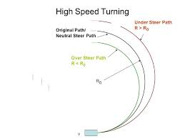
2. High-Speed Turning
High-speed turning introduces additional dynamics such as lateral acceleration, weight transfer, and the influence of aerodynamics. Unlike low-speed turns, the stability of the vehicle becomes a critical factor at higher speeds.
Key Challenges in High-Speed Turning:
Centrifugal Force: Acts outward from the center of the curve, increasing with the square of speed. The tires must counter this force to maintain grip.
Role of Downforce: High-speed vehicles, like race cars, rely on aerodynamic features such as spoilers to increase downforce and enhance grip.
Example in Vehicle Dynamics:
During a high-speed corner, a sports car with aerodynamic aids like a rear spoiler can maintain higher lateral acceleration without losing traction compared to a sedan.

Slide 41
3. Understeer and Oversteer
Understeer and oversteer describe how a vehicle responds to steering inputs during cornering. These behaviors depend on the balance of lateral forces between the front and rear tires.
Understeer: Occurs when the front tires lose grip before the rear tires, causing the vehicle to turn less sharply than intended.
Common in front-wheel-drive vehicles.
Can be mitigated by reducing speed or adjusting steering input.
Oversteer: Occurs when the rear tires lose grip before the front tires, causing the vehicle to turn more sharply than intended.
Common in rear-wheel-drive vehicles.
Requires skilled counter-steering to correct.
Neutral Steering: Occurs when both front and rear tires lose grip simultaneously, resulting in a balanced response to steering input.
Example in Vehicle Dynamics:
A rear-wheel-drive sports car is more prone to oversteer during aggressive cornering, while a front-wheel-drive sedan is more likely to exhibit understeer.

Slide 42
4. Roll and Weight Transfer Equation
Weight transfer during cornering causes the load on the tires to shift laterally, which affects grip and stability. Roll occurs as the vehicle’s body tilts toward the outside of the turn due to lateral acceleration.
Factors Influencing Roll:
Higher CoG increases weight transfer and roll.
Wider track width reduces the effects of weight transfer.
Example in Vehicle Dynamics:
An SUV with a high CoG is more prone to rolling over during sharp turns compared to a sports car with a low CoG and wider track width.

Slide 43
10.Handling And Steering Performance
Label option
1. Steering Ration
2.Steady State Handling Test
3.Double Lane Change Test
4. Turing Circle Diameter
5. Steering Returnability Performance
6. Steering On Centre Performance
Company confidential

Slide 44
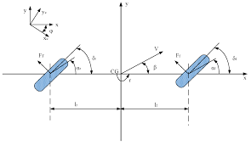
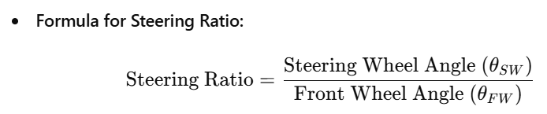
Handling and Steering Performance
Handling and steering performance evaluate a vehicle's ability to respond accurately to driver inputs and maintain stability during various maneuvers. These characteristics significantly influence the driving experience, safety, and control of the vehicle.
1. Steering Ratio
The steering ratio is the ratio of the steering wheel's rotation to the corresponding rotation of the front wheels. It determines how much the driver needs to turn the steering wheel to achieve a specific change in wheel angle.
Interpretation:
A high steering ratio (e.g., 20:1) means the driver needs to turn the steering wheel more for the same wheel angle. Common in trucks for stability.
A low steering ratio (e.g., 12:1) means less steering effort is required, ideal for sporty and responsive vehicles.
Example in Vehicle Dynamics:
Sports cars often have a low steering ratio for quick handling, while trucks prioritize higher ratios for precise control at low speeds.

Slide 45
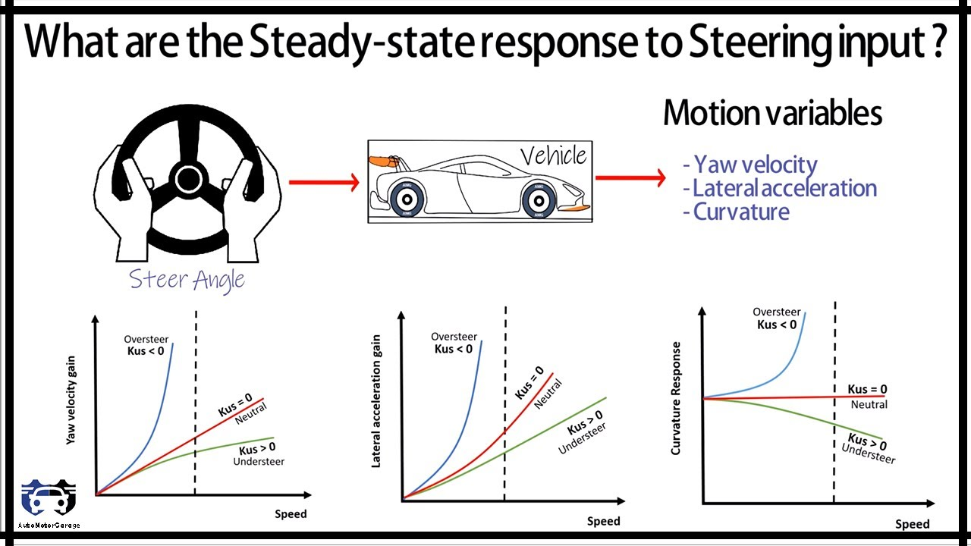
2. Steady-State Handling Test
The steady-state handling test evaluates a vehicle's cornering behavior under constant speed and steering input, revealing tendencies like understeer, oversteer, or neutral handling.
Procedure:
The vehicle is driven in a circular path at increasing speeds.
Steering input and lateral acceleration are monitored to determine how the vehicle responds to the driver’s inputs.
Key Metrics:
Understeer Gradient: Describes the change in steering angle required with increasing lateral acceleration.
Neutral Steer Speed: The speed at which no additional steering input is needed.
Example in Vehicle Dynamics:
A well-balanced vehicle maintains neutral handling in a steady-state test, with no abrupt loss of grip at either the front or rear wheels.

Slide 46
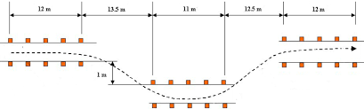
3. Double Lane Change Test
The double lane change test simulates a sudden evasive maneuver, such as avoiding an obstacle on the road, to evaluate the vehicle's stability and responsiveness.
Procedure:
The vehicle navigates two consecutive lane changes at increasing speeds without braking.
Driver input, body roll, and tire performance are measured.
Importance:
Highlights the vehicle’s agility and ability to maintain control during rapid directional changes.
Example in Vehicle Dynamics:
SUVs with advanced stability control systems perform better in this test by minimizing body roll and maintaining grip during rapid lane changes.

Slide 47
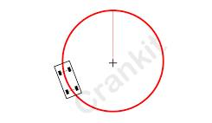
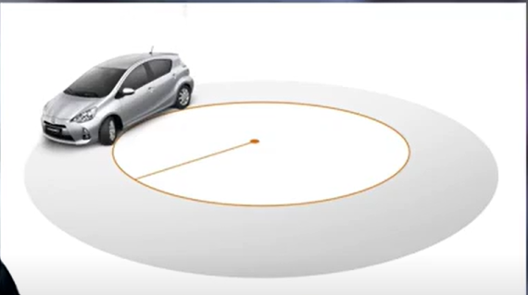
4. Turning Circle Diameter
The turning circle diameter is the smallest circular path that a vehicle can achieve during a full lock turn. It is a measure of the vehicle’s maneuverability.
Factors Affecting Turning Circle:
Wheelbase: A shorter wheelbase reduces the turning circle.
Steering Angle: A larger maximum steering angle reduces the turning circle.
Track Width: Wider vehicles may require a larger turning circle.
Typical Values:
Compact cars: 9–10 meters.
SUVs or trucks: 12–14 meters.
Example in Vehicle Dynamics:
A compact city car with a small turning circle diameter is easier to maneuver in tight parking spaces than a full-size SUV.

Slide 48
5. Steering Returnability Performance
Steering returnability refers to the steering system's ability to return to the center position after a turn, aided by caster angle and suspension geometry.
Key Factors:
Caster Angle: A positive caster angle helps the wheels naturally align with the forward direction.
Suspension Design: Proper alignment and stiffness contribute to smooth returnability.
Importance:
Enhances driving comfort by reducing the need for driver corrections.
Improves straight-line stability.
Example in Vehicle Dynamics:
A sedan with a well-tuned suspension and caster angle will have excellent returnability, reducing driver fatigue during long drives.

Slide 49
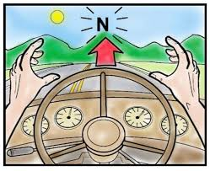
6. Steering On-Centre Performance
Steering on-center performance evaluates the precision and stability of the steering system when the steering wheel is near its neutral position (straight ahead).
Key Attributes:
Responsiveness: How quickly the vehicle responds to small steering inputs.
Stability: The ability to maintain a straight path without frequent corrections.
Importance:
Critical for highway driving, where minor steering inputs are needed for lane-keeping.
Reduces driver fatigue during long-distance travel.
Example in Vehicle Dynamics:
A luxury sedan with precise steering on-center performance provides a smooth and stable driving experience on highways.

Slide 50
11. vertical dynamics
Label option
1.Sources of Vibration And Spring
2.Damping Effect
3.Wheel Rate And Motion Ration Derivation
4. Ride Perception
Company confidential

Slide 51
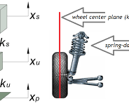
Vertical Dynamics
Vertical dynamics focus on the motion of a vehicle along the vertical axis, which includes bouncing, pitching, and rolling. These dynamics are crucial for ensuring passenger comfort, vehicle stability, and ride quality. Key components like springs, dampers, and suspension geometry play a vital role in managing these forces.
1. Sources of Vibration, and Spring
Vertical vibrations in a vehicle originate from various sources, such as uneven road surfaces, potholes, and drivetrain irregularities. The vehicle’s suspension system, particularly the springs, plays a critical role in absorbing and mitigating these vibrations.
Key Concepts:
Springs: Store and release energy to smooth out road irregularities.
Sources of Vibrations:
Tire-road interactions (primary source).
Engine and drivetrain vibrations.
Aerodynamic turbulence at high speeds.
Example in Vehicle Dynamics:
A luxury sedan has soft springs and optimized suspension to minimize vibrations, offering a smooth ride on rough roads.

Slide 52
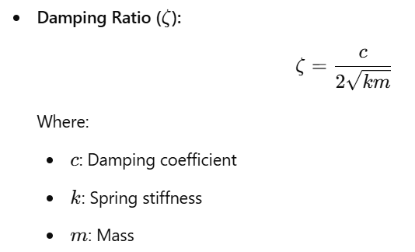
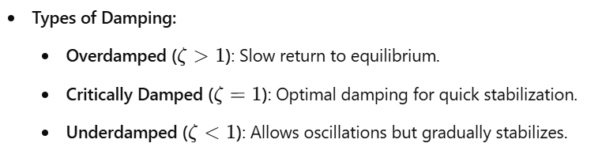
2. Damping Effect
The damping effect is provided by shock absorbers (dampers), which dissipate the energy stored in the springs to control oscillations and prevent excessive bouncing.
Importance: Effective damping prevents prolonged oscillations, ensuring both comfort and stability.
Example in Vehicle Dynamics:
Off-road vehicles use stiffer dampers to control larger vertical movements
over rough terrain.

Slide 53
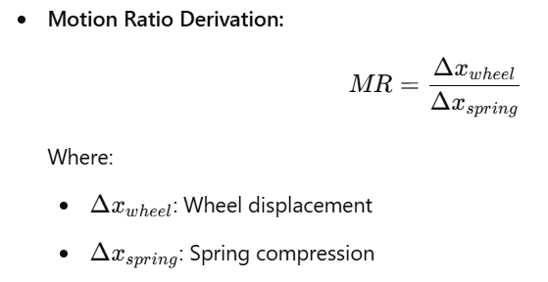
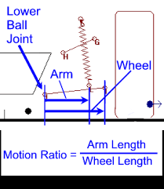
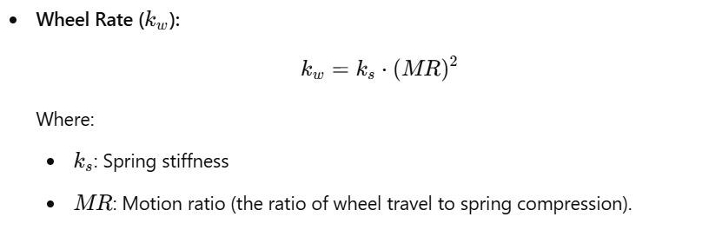
3. Wheel Rate and Motion Ratio Derivation
The wheel rate is the effective stiffness of the suspension system as "felt" by the wheels. The motion ratio accounts for how suspension geometry affects the spring's effective behavior.
Example in Vehicle Dynamics:
A racing car has a high wheel rate and carefully tuned motion ratios to provide precise control and limit excessive suspension movement during high-speed cornering.

Slide 54
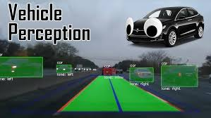
4. Ride Perception
Ride perception refers to how passengers feel the vertical motion of a vehicle. A balance between stiffness and damping is essential to provide both comfort and handling.
Factors Influencing Ride Perception:
Springs: Stiffer springs improve handling but reduce comfort.
Dampers: Control oscillations to maintain a smooth ride.
Road Surface: Rough roads amplify vertical dynamics, impacting comfort.
Perception Metrics:
Body Acceleration: Lower values are more comfortable.
Frequency Range: Human sensitivity is highest between 1-5 Hz, so tuning below this range is ideal.
Example in Vehicle Dynamics:
A luxury SUV prioritizes ride comfort with soft suspension and advanced damping systems, while sports cars trade some comfort for precise handling and performance.

Slide 55
12. Roll Over Dynamics
Label option
11. Mechanism Of Roll Over
2. Static Stability Factor
Company confidential

Slide 56
Roll Over Dynamics
Rollover is one of the most dangerous outcomes of vehicle instability, especially for vehicles with a high center of gravity (CoG) like SUVs and trucks. Understanding its mechanism and factors like the Static Stability Factor (SSF) helps engineers design safer vehicles and reduce rollover risks.
1. Mechanism of Roll Over
Rollover occurs when the lateral forces acting on a vehicle cause it to tip over its side. This typically happens during high-speed cornering, evasive maneuvers, or collisions. Key contributors to rollover include:
Lateral Acceleration : As the vehicle turns, centrifugal force pushes the vehicle outward, generating lateral acceleration.
If this force exceeds the resistance provided by the tires and suspension, the vehicle begins to roll.
Center of Gravity (CoG): A higher CoG increases the moment arm, amplifying the rollover torque.
Lowering the CoG reduces the risk of rollover.
Weight Transfer: During sharp turns or uneven terrains, weight shifts to the outer wheels. If the load on the inner wheels becomes zero, the vehicle tips.
Tripping Forces: External forces like hitting a curb or obstacle can induce rollover by creating additional torque on the vehicle.
Example in Vehicle Dynamics:
SUVs are more prone to rollover compared to sedans due to their higher CoG and narrower track width.

Slide 57
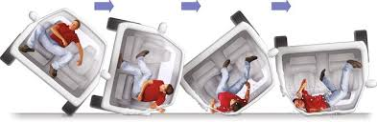
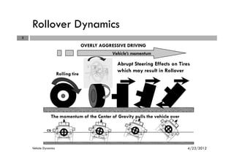

Slide 58
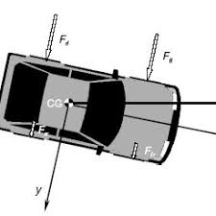
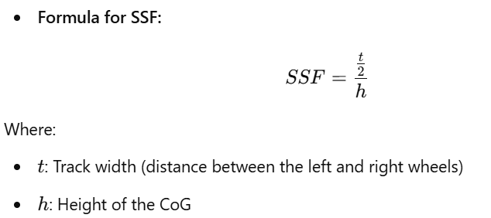
2. Static Stability Factor (SSF)
The Static Stability Factor (SSF) is a measure of a vehicle’s inherent resistance to rollover during cornering. It is defined by the relationship between the track width and the height of the CoG
Preventive Measures:
Lower CoG: Reducing the CoG by design
(e.g., lowering the engine
position) can enhance stability.
Wider Track Width: Increasing the distance between the left and right wheels improves SSF.
Electronic Stability Control (ESC): Helps prevent rollover by detecting loss of control and applying brakes selectively to maintain stability.
Improved Suspension Design: Tuned suspension systems reduce weight transfer and mitigate rollover tendencies.

Slide 59
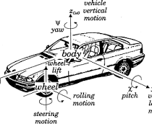
Overall View on Vehicle Dynamics
Vehicle dynamics encompasses the study of forces and motions that affect a vehicle's behavior on the road. It is a multidisciplinary field blending concepts from physics, mechanical engineering, and control systems to enhance performance, safety, and comfort. Vehicle dynamics is essential for designing vehicles that perform optimally under a variety of driving conditions.

Slide 60



Thank You
Automobile Engineering: Vehicle dynamics for Beginners
-Akhila Vulluri

